Slide 1
Unit 202: Principles of electrical science
Resistors in parallel

Slide 2
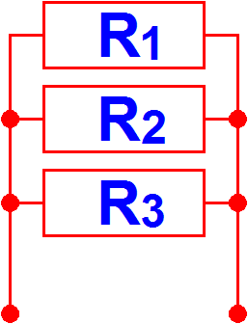
Resistors in parallel
1 | = | 1 | + | 1 | + | 1
R_{T} |  | R₁ |  | R₂ |  | R₃

Slide 3
Example 1
Calculate the total resistance of a parallel circuit if: R₁ = 9Ω, R₂ = 12Ω and R₃ = 18Ω.
1 | = | 1 | + | 1 | + | 1
R_{T} |  | R₁ |  | R₂ |  | R₃
1 | = | 1 | + | 1 | + | 1
R_{T} |  | 9 |  | 12 |  | 18
Find the lowest common denominator, which is 36:
1 | = | 4 + 3 + 2
R_{T} |  | 36
1 | = | 9
R_{T} |  | 36

Slide 4
Example 1
Inverting both sides of the equation will give us R_{t}:
R_{T} | = | 36
 |  | 9
 | = | 4Ω
The total resistance of the circuit will determine the amount of current that will flow in that circuit.

Slide 5
Example 2
Calculate the total resistance of a parallel circuit if R₁ = 45Ω, R₂ = 90Ω and R₃ = 30Ω .
1 | = | 1 | + | 1 | + | 1
R_{T} |  | R₁ |  | R₂ |  | R₃
1 | = | 1 | + | 1 | + | 1
R_{T} |  | 45 |  | 90 |  | 30
Find the lowest common denominator, which is 90:
1 | = | 2 + 1 + 3
R_{T} |  | 90
1 | = | 6
R_{T} |  | 90

Slide 6
Example 2
Inverting both sides of the equation will give us R_{t}:
R_{T} | = | 90
 |  | 6
 | = | 15Ω

Slide 7
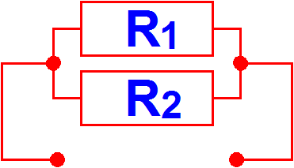
Example 3
Calculate the total resistance of two resistors connected in parallel if R₁ = 6Ω and R₂ = 4Ω.
R_{T} | = | R₁ × R₂
 |  | R₁ + R₂
 | = | 6 × 4
 |  | 6 + 4
 | = | 24
 |  | 10
 | = | 2.4Ω

Slide 8
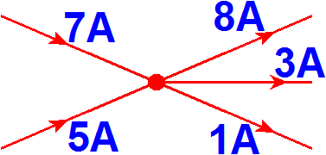
Kirchoff’s Current law
The sum of the currents arriving at a point must equal the sum of the currents leaving that point.
I_{T} = I₁ + I₂ + I₃

Slide 9
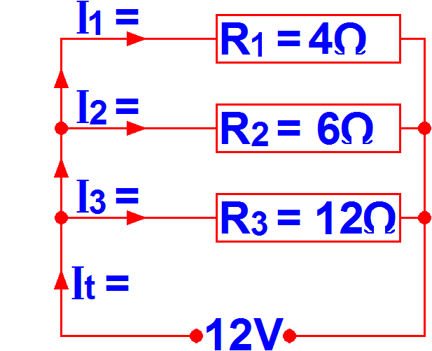
Example 4
I₁ | =
V
R₁
=
12
4
=
3 amps
I₂ | =
V
R₂
=
12
6
=
2 amps
I₃ | =
V
R₃
=
12
12
=
1 amps

Slide 10
Example 4
1 | = | 1 | + | 1 | + | 1
R_{T} |  | R₁ |  | R₂ |  | R₃
1 | = | 1 | + | 1 | + | 1
R_{T} |  | 4 |  | 6 |  | 12
1 | = | 3 + 2 + 1
R_{T} |  | 12
1 | = | 6
R_{T} |  | 12
R_{T} | = | 12
 |  | 6
 | = | 12
 |  | 6
 | = | 2Ω

Slide 11
Example 4
I_{T} | = | V
 |  | R_{T}
 | = | 12
 |  | 2
 | = | 6 amps - Kirchhoff’s law is proved

Slide 12
Unit 202: Principles of electrical science
The End

